Slide 1


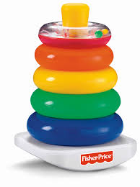

Data Structures And Algorithms
Department of Software Engineering

Slide 2
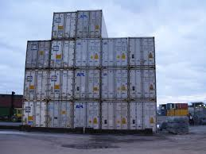
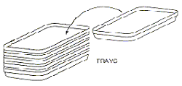

Stacks
A stack is a sequence of items that are accessible at only one end of the sequence.

Slide 3
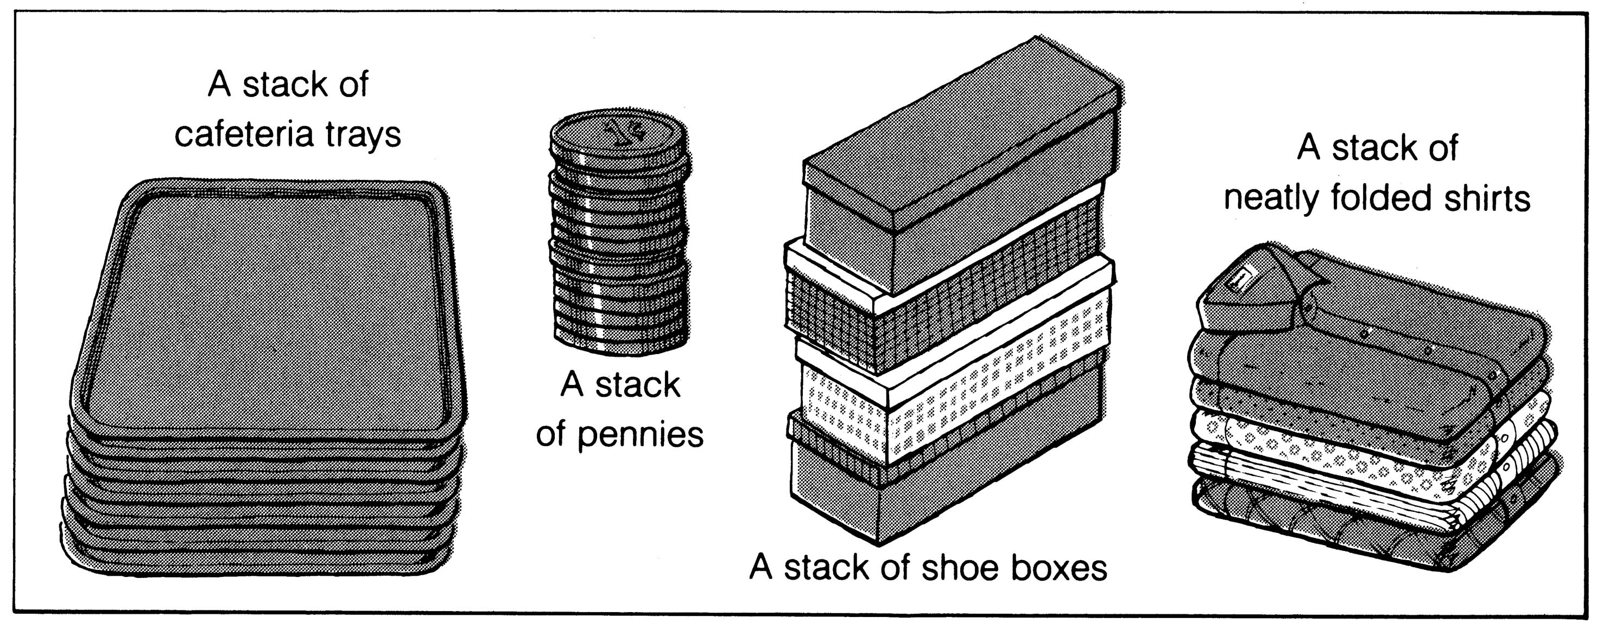
What is a Stack ?????????????????
It is an ordered group of homogeneous items of elements.
Elements are added to and removed from the top of the stack (the most recently added items are at the top of the stack).
The last element to be added is the first to be removed (LIFO: Last In, First Out).

Slide 4
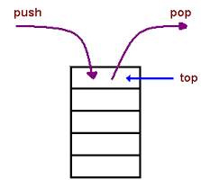
STACK OPERATIONS
POP – Deleting the top value of the stack
PUSH – Inserting a value inside stack
TOP – Location of the last Inserted value inside stack

Slide 5
Basic Stack Operations
The stack concept is introduced and three basic stack operations are discussed.
Stack Creation
Push
Pop
Stack Top
Stack Full

Slide 6

AUXILIARY OPERATIONS OF STACK
int top() or peek() : Returns the last inserted elements without removing it.
int size() : Returns the number of elements stored in stack.
boolean isStackFull() : Check whether stack is full or not.
boolean isEmpty() : Check whether stack is empty or not.

Slide 7
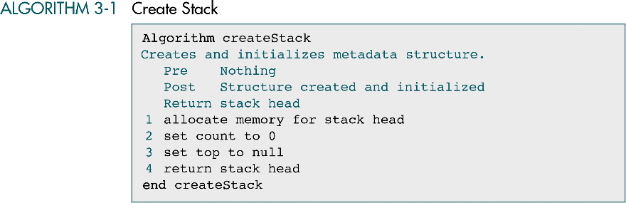
STACK CREATION

Slide 8

Push - Insert Operation
Function: Adds newItem to the top of the stack.
Preconditions: Stack has been initialized and is not full.
Postconditions: newItem is at the top of the stack.
Stack overflow
The condition resulting from trying to push an element onto a full stack.
if(!stack.IsFull())
stack.Push(item);

Slide 9
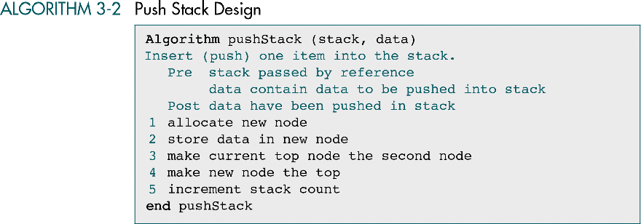
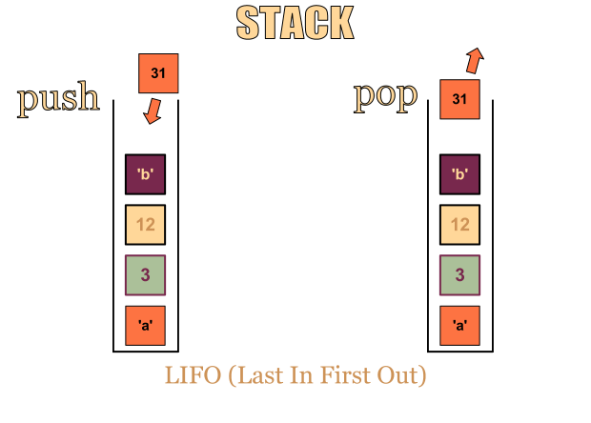
STACK INSERTION

Slide 10

Pop (Delete Operation)
Function: Removes topItem from stack and returns it in item.
Preconditions: Stack has been initialized and is not empty.
Postconditions: Top element has been removed from stack and item is a copy of the removed element.
Stack underflow
The condition resulting from trying to pop an empty stack.
if(!stack.IsEmpty())
stack.Pop(item);

Slide 11
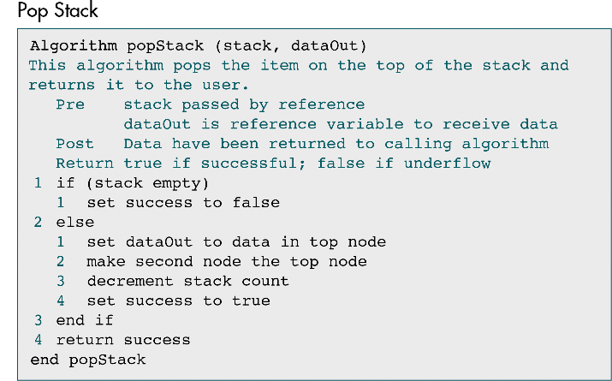
STACK - DELETION

Slide 12
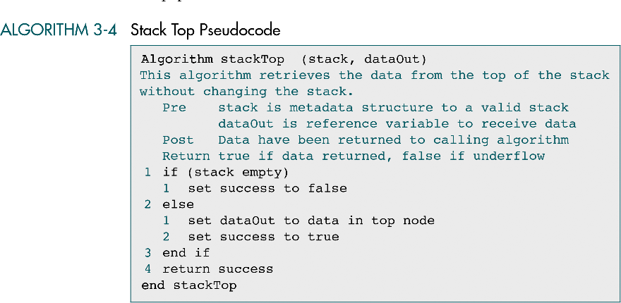

STACK TOP

Slide 13
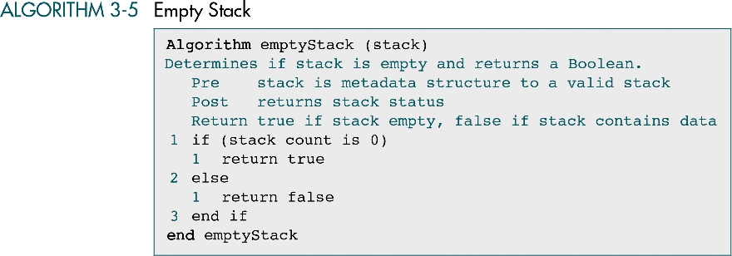
EMPTY STACK

Slide 14
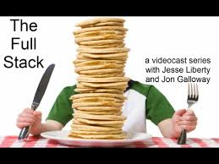
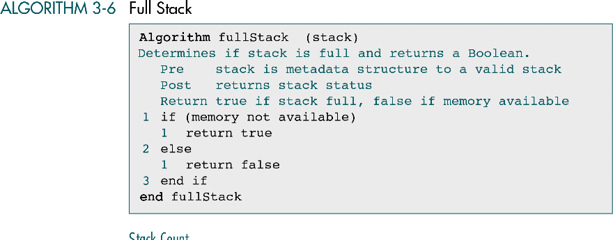
FULL STACK

Slide 15
Last In First Out
B
A
C
B
A
D
C
B
A
E
D
C
B
A
top
D
C
B
A
top
top
top
A
top

Slide 16
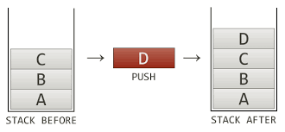
Stack Implementations
Array based
Where is top?
How are elements added, removed?
Linked List based
Where is top?
How are elements added, removed?

Slide 17

APPLICATIONS OF STACK
Direct applications
Page-visited history in a Web browser
Undo sequence in a text editor
Saving local variables when one function calls another, and this one calls another, and so on.
Expression evaluation and syntax parsing
Backtracking
Indirect applications
Auxiliary data structure for algorithms
Component of other data structures

Slide 18
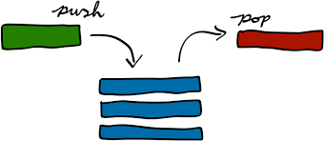
Some uses of stacks
Stacks are used for:
Any sort of nesting (such as parentheses)
Evaluating arithmetic expressions (and other sorts of expression)
Implementing function or method calls
Keeping track of previous choices (as in backtracking)
Keeping track of choices yet to be made (as in creating a maze)

Slide 19
Array-based Stack Implementation
Allocate an array of some size (pre-defined)
Maximum N elements in stack
Bottom stack element stored at element 0
last index in the array is the top
Increment top when one element is pushed, decrement after pop

Slide 20
Stack Implementation:CreateS, isEmpty, isFull
// Top operation to return element at top of stack.
Int Top() { return A[top]; }
// This function will return 1 (true) if stack is empty, 0 (false) otherwise
int IsEmpty()
{
if(top == -1) return 1;
return 0;
}

Slide 21
// Push operation to insert an element on top of stack. void Push(int x) { if(top == MAX_SIZE -1) { // overflow case. printf("Error: stack overflow\n"); return; } A[++top] = x; }
Push

Slide 22
// Pop operation to remove an element from top of stack. void Pop() { if(top == -1) { // If stack is empty, pop should throw error. printf("Error: No element to pop\n"); return; } top--; }
Pop

Slide 23
LINKED LIST REPRESENTATION OF STACKS
Stacks can be represented using singly link list
Advantages of using linked list are
Dynamic size
Ease of insertion and deletion
Each node in the stack should contain two parts:
INFO: the user's data
NEXT: hold pointers to the neighboring element

Slide 24
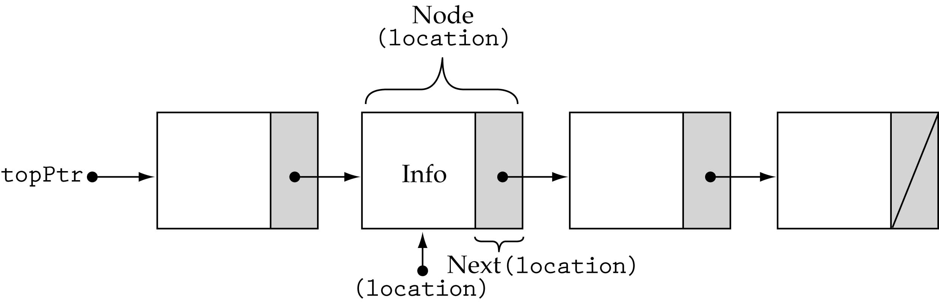
Linked Representation of Stack
Top pointer – Top of Stack
Null pointer – Bottom of Stack
Push operation – Inserting a node to the top
Pop operation – Deleting a node from the top

Slide 25
List Stack Example
push(6);
top
6

Slide 26
List Stack Example
push(6);
push(1);
top
1
6

Slide 27
List Stack Example
push(6);
push(1);
push(7);
7
top
1
6

Slide 28
List Stack Example
push(6);
push(1);
push(7);
push(8);
8
7
top
1
6

Slide 29
List Stack Example
push(6);
push(1);
push(7);
push(8);
pop();
8
7
top
1
6

Slide 30
List Stack Example
push(6);
push(1);
push(7);
push(8);
pop();
7
top
1
6

Slide 31
Implementation of linked stacks
1) Declare the element of the stack
struct node
{
int data;
struct node* next;
};
2) initialize the stack by setting the head pointer of the stack to NULL
void init(struct node* head) { head = NULL; }

Slide 32
Creating stack and destroying stack
/* Create empty stack */
void create()
{
top = NULL;
}
/* Destroy entire stack */
void destroy()
{
top1 = top;
while (top1 != NULL)
{
top1 = top->ptr;
free(top);
top = top1;
top1 = top1->ptr;
}
free(top1);
top = NULL;
printf("\n All stack elements destroyed");
count = 0;
}

Slide 33
Stack Implementation:returnTop, isEmpty, isFull
/* Return top element */
int topelement()
{
return(top->info);
}
/* Check if stack is empty or not */
void empty()
{
if (top == NULL)
printf("\n Stack is empty");
else
printf("\n Stack is not empty with %d elements", count);
}

Slide 34
/* Push data into stack */ void push(int data) { if (top == NULL) { top =(struct node *)malloc(sizeof(struct node)); top->next = NULL; top->info = data; } else { temp =(struct node *)malloc(sizeof(struct node)); temp->next = top; temp->info = data; top = temp; } count++; }
Push

Slide 35
/* Pop Operation on stack */ void pop() { top1 = top; if (top1 == NULL) { printf("\n Error : Trying to pop from empty stack"); return; } else top1 = top1->next; printf("\n Popped value : %d", top->info); free(top); top = top1; count--; }
Pop

Slide 36
/* Display stack elements */ void display() { top1 = top; if (top1 == NULL) { printf("Stack is empty"); return; } while (top1 != NULL) { printf("%d ", top1->info); top1 = top1->next; } }
Display

Slide 37

Advantages & Disadvantage
Advantages (Pros) * Easy to get started * Low Hardware Requirement * Cross- Platform
Disadvantages (Cons) * Inflexible * Lack of scalability

Slide 38
Applications of Stack
Infix to postfix Expression
Evaluation of postfix
Balancing Symbols
Recursion-Nested Function Calls
Towers of Hanoi

Slide 39
Infix to Postfix conversion

Slide 40
Infix notation
Infix notation is the common arithmetic and logical formula notation, in which operators are written infix-style between the operands they act on
E.g. A + B

Slide 41
Postfix notation
In Postfix notation, the operator comes after the Operand.
For example, the Infix expression A+B will be written as AB+ in its Postfix Notation.
Postfix is also called ‘Reverse Polish Notation’

Slide 42
Prefix notation
In Prefix notation, the operator comes before the operand.
The Infix expression A+B will be written as +AB in its Prefix Notation.
Prefix is also called ‘Polish Notation’

Slide 43
Conversion from Infix to Postfix Algorithm
Step1
Scan the Infix expression from left to right for tokens (Operators, Operands & Parentheses) and perform the steps 2 to 5 for each token in the Expression

Slide 44
Algorithm
Step2
If token is operand, Append it in postfix expression
Step3
If token is a left parentheses “(“, push it in stack.

Slide 45
Algorithm
Step4
If token is an operator,
Pop all the operators which are of higher or equal precedence then the incoming token and append them (in the same order) to the output Expression.
After popping out all such operators, push the new token on stack.

Slide 46
Algorithm
Step5
If “)” right parentheses is found,
Pop all the operators from the Stack and append them to Output String, till you encounter the Opening Parenthesis “(“.
Pop the left parenthesis but don’t append it to the output string (Postfix notation does not have brackets).

Slide 47
Algorithm for Infix to Postfix
1) Examine the next element in the input.
2) If it is operand, output it.
3) If it is opening parenthesis, push it on stack.
4) If it is an operator, then
i) If stack is empty, push operator on stack.
ii) If the top of stack is opening parenthesis, push operator on stack
iii) If it has higher priority than the top of stack, push operator on stack.
iv) Else pop the operator from the stack and output it, repeat step 4
5) If it is a closing parenthesis, pop operators from stack and output them until an opening parenthesis is encountered. pop and discard the opening parenthesis.
6) If there is more input go to step 1
7) If there is no more input, pop the remaining operators to output.

Slide 48
Algorithm
Step6
When all tokens of Infix expression have been scanned. Pop all the elements from the stack and append them to the Output String.
The Output string is the Corresponding Postfix Notation.

Slide 49
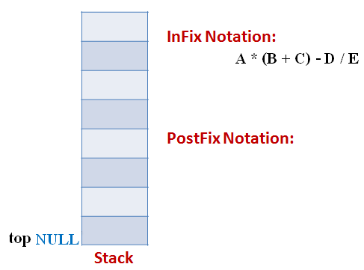
Example
Let the incoming the Infix expression be:
A * (B + C) – D / E
Stage 1: Stack is empty and we only have the Infix Expression.

Slide 50
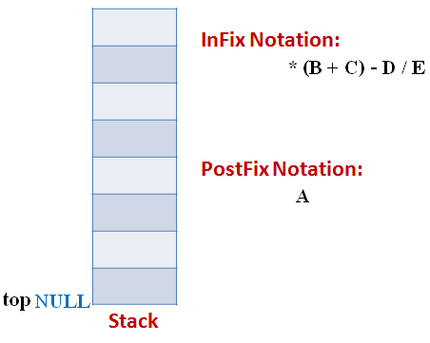
Example
Stage 2
The first token is Operand A Operands are Appended to the Output as it is.

Slide 51
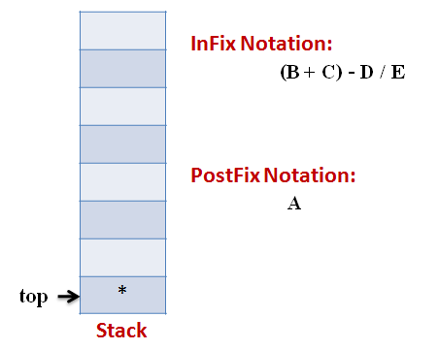
Example
Stage 3
Next token is * Since Stack is empty (top==NULL) it is pushed into the Stack

Slide 52
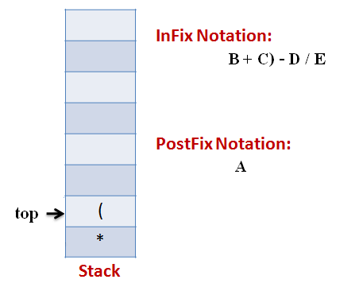
Example
Stage 4
Next token is ( the precedence of open-parenthesis, when it is to go inside, is maximum.
But when another operator is to come on the top of ‘(‘ then its precedence is least.

Slide 53
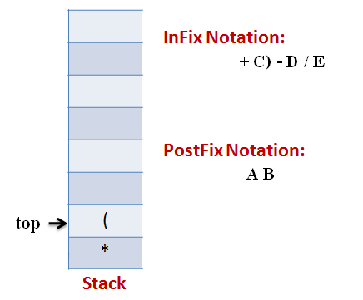
Example
Stage 5
Next token, B is an operand which will go to the Output expression as it is

Slide 54
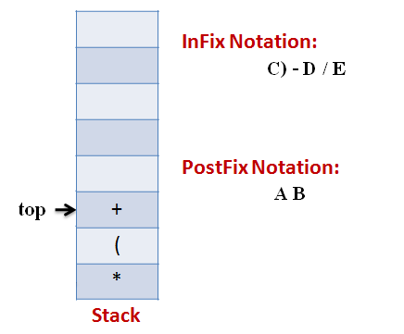
Example
Stage 6
Next token, + is operator, We consider the precedence of top element in the Stack, ‘(‘. The outgoing precedence of open parenthesis is the least (refer point 4. Above). So + gets pushed into the Stack

Slide 55
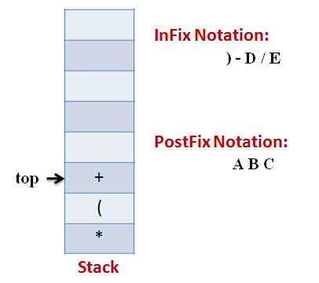
Example
Stage 7
Next token, C, is appended to the output

Slide 56
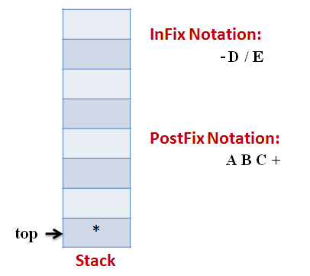
Example
Stage 8
Next token ), means that pop all the elements from Stack and append them to the output expression till we read an opening parenthesis.

Slide 57
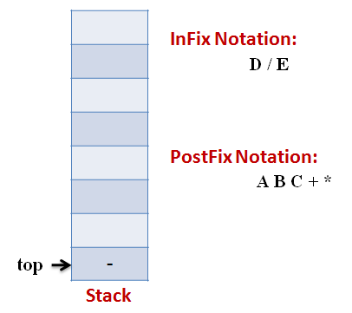
Example
Stage 9
Next token, -, is an operator. The precedence of operator on the top of Stack ‘*‘ is more than that of Minus. So we pop multiply and append it to output expression. Then push minus in the Stack.

Slide 58
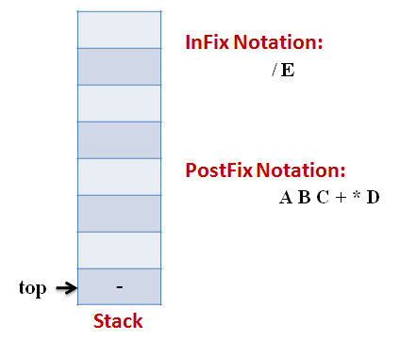
Example
Stage 10
Next, Operand ‘D‘ gets appended to the output.

Slide 59
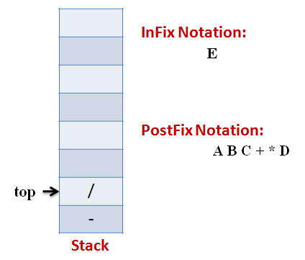
Example
Stage 11
Next, we will insert the division operator into the Stack because its precedence is more than that of minus.

Slide 60
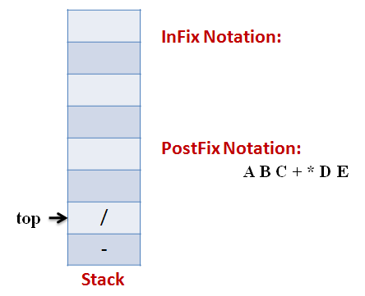
Example
Stage 12
The last token, E, is an operand, so we insert it to the output Expression as it is.

Slide 61
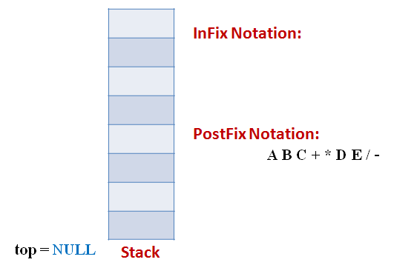
Example
Stage 13
The input Expression is complete now. So we pop the Stack and Append it to the Output Expression as we pop it.

Slide 62
Suppose we want to convert 2*3/(2-1)+5*3 into Postfix form,
Expression | Stack | Output
2 | Empty | 2
* | * | 2
3 | * | 23
/ | / | 23*
( | /( | 23*
2 | /( | 23*2
- | /(- | 23*2
1 | /(- | 23*21
) | / | 23*21-
+ | + | 23*21-/
5 | + | 23*21-/5
* | +* | 23*21-/53
3 | +* | 23*21-/53
 | Empty | 23*21-/53*+
So, the Postfix Expression is 23*21-/53*+

Slide 63
Evaluation of a Postfix expression
Add a paranthesis “)” at the end of P
Scan P from left to right and repeat Step 3 and 4 for each element of P until “)” is encountered
If an operand is encountered, put it on STACK
If an operator o is encountered, then:
a) Remove the two top elements of STACK, where A is the top element and B is the next-to-top element.
b) Evaluate B o A.
c) Place the result of (b) back on stack
[End of If structure]
[End of Step 2 loop]
Set VALUE equal to the top element on STACK
Exit

Slide 64
Advantages of Postfix Expression:
(A). Postfix notation is easier to work with. In a postfix expression operators operands appear before the operators, there is no need of operator precedence and other rules.
(B). In postfix expression, there are no parentheses and therefore the order of evaluation will be determined by the positions of the operators and related operands in the expression.

Slide 65
4
3
*
6
7
+
5
-
+
)

Slide 66
(
4
3
*
6
7
+
5
-
+
)
Push the opening bracket ‘(‘ into the stack .
STACK

Slide 67
4
3
7
+
5
+
)
4
*
6
-
(
Operand ‘4’ push it into the stack
STACK

Slide 68
4
3
7
+
5
+
)
3
*
6
-
4
Operand ‘3’ push it into the stack.
(
STACK

Slide 69
4
3
*
7
+
5
+
)
*
6
-
3
4
Now comes Operator ‘*’
(
STACK

Slide 70
4
3
*
6
7
+
5
-
+
)
*
3
4
Pop operand ‘3’ and ‘4’
(
STACK

Slide 71
4
3
*
6
7
+
5
-
+
)
4
*
3
Evaluate the expression
4*3 =12
Pus it into the stack
(
STACK

Slide 72
4
3
*
6
7
+
5
-
+
)
4
*
3
12
Evaluate the expression
4*3 =12
(
STACK

Slide 73
4
3
*
6
7
+
5
-
+
)
4
*
12
3
Push it into the stack
(
STACK

Slide 74
4
3
*
6
7
+
5
+
)
6
-
Operand ‘6’ push it into the stack
12
(
STACK

Slide 75
3
7
5
+
4
*
6
7
+
-
)
6
12
Operand ‘7’ push it into the stack
(
STACK

Slide 76
3
7
+
5
+
)
4
*
6
+
-
Operand ‘7’ and ‘6’
Are popped
7
6
12
Operand ‘+’ push it into the stack
(
STACK

Slide 77
4
3
*
6
7
+
5
-
+
)
+
7
13
6
Evaluate ‘6+7’
=13
12
(
STACK

Slide 78
4
3
*
6
7
+
5
-
+
)
13
Push it into the stack
12
(
STACK

Slide 79
3
5
4
*
6
7
+
5
-
+
)
Operand ‘5’ push it into the stack
13
12
(
STACK

Slide 80
4
3
*
6
7
+
5
-
+
)
-
Operands ‘5’ and ‘13’ are popped
5
13
12
Now operator ‘-’ occurs
(
STACK

Slide 81
4
3
*
6
7
+
5
-
+
)
8
Evaluating “13-5”
We get ‘8’
12
(
STACK

Slide 82
4
3
*
6
7
+
5
-
+
)
8
Now, push the resultant value i.e ‘8’ in the stack
12
(
STACK

Slide 83
3
5
+
4
*
6
7
+
-
+
)
8
Operator ‘+’
12
(
STACK

Slide 84
4
3
*
6
7
+
5
-
+
)
20
+
12
8
By Evaluating , we get
20
(
STACK

Slide 85
4
3
*
6
7
+
5
-
+
)
20
So push ‘20’ in stack
(
STACK

Slide 86
3
7
5
+
)
4
*
6
+
-
)
Now atlast ‘)’ occurs
20
Now , pop the element till the opening bracket
(
STACK

Slide 87
4
3
*
6
7
+
5
-
+
)
)
20
(
STACK

Slide 88
4
3
*
6
7
+
5
-
+
)
20
Now push the element
AND THE FINAL ANSWRER IS ’20’
()
STACK

Slide 89
Balanced Symbol Checking
In processing programs and working with computer languages there are many instances when symbols must be balanced
{ } , [ ] , ( )
A stack is useful for checking symbol balance. When a closing symbol is found it must match the most recent opening symbol of the same type.
Applicable to checking html and xml tags!

Slide 90
Algorithm for Balanced Symbol Checking
Make an empty stack
read symbols until end of file
if the symbol is an opening symbol push it onto the stack
if it is a closing symbol do the following
if the stack is empty report an error
otherwise pop the stack. If the symbol popped does not match the closing symbol report an error
At the end of the file if the stack is not empty report an error

Slide 91
Example
EXAMPLE | Valid? | Description
(A+B) + (C-D) | Yes | The expression is having balanced symbol
((A+B) + (C-D) | No | One closing brace is missing.
((A+B) + [C-D]) | Yes | Opening and closing braces correspond
((A+B) + [C-D]] | No | The last brace does not correspond with the first opening brace.

Slide 92
For tracing the algorithm let us assume that the input is () (() [()])
Input Symbol | Operation | Stack | Output
( | Push ( | (
) | Pop ( Test if ( and A[i] match? YES
( | Push ( | (
( | Push ( | ( (
) | Pop ( Test if ( and A[i] match? YES | (
[ | Push [ | ( [
( | Push ( | ( [ (
) | Pop ) Test if ( and A[i] match? YES | ( [
] | Pop [ Test if [ and A[i] match? YES | (
) | Pop ( Test if ( and A[i] match? YES
 | Test if Stack is Empty? YES |  | TRUE

Slide 93
Real Time Example Supporting Recursion
static int factorial(int n) { if (n <= 1) return 1; else return n * factorial(n - 1); }
If you call x = factorial(3), this enters the factorial method with n=3 on the stack
| factorial calls itself, putting n=2 on the stack
| | factorial calls itself, putting n=1 on the stack
| | factorial returns 1
| factorial has n=2, computes and returns 2*1 = 2
factorial has n=3, computes and returns 3*2 = 6

Slide 94
Factorial (animation 1)
x = factorial(3)
static int factorial(int n) { //n=3 int r = 1; if (n <= 1) return r; else { r = n * factorial(n - 1); return r; } }
3 is put on stack as n
r is put on stack with value 1
All references to r use this r
r=1
All references to n use this n
n=3
Now we recur with 2...

Slide 95
Factorial (animation 2)
r = n * factorial(n - 1);
static int factorial(int n) {//n=2 int r = 1; if (n <= 1) return r; else { r = n * factorial(n - 1); return r; } }
2 is put on stack as n
r is put on stack with value 1
Now using this r
r=1
And this n
n=2
r=1
n=3
Now we recur with 1...

Slide 96
Factorial (animation 3)
r = n * factorial(n - 1);
static int factorial(int n) { int r = 1; if (n <= 1) return r; else { r = n * factorial(n - 1); return r; } }
1 is put on stack as n
r=1
Now using this r
r is put on stack with value 1
And this n
n=1
r=1
n=2
r=1
Now we pop r and n off the stack and return 1 as factorial(1)
n=3

Slide 97
Factorial (animation 4)
r = n * factorial(n - 1);
static int factorial(int n) { int r = 1; if (n <= 1) return r; else { r = n * factorial(n - 1); return r; } }
r=1
r=1
Now using this r
And this n
n=1
n=1
fac=1
r=1
n=2
r=1
Now we pop r and n off the stack and return 1 as factorial(1)
n=3

Slide 98
Factorial (animation 5)
r = n * factorial(n - 1);
static int factorial(int n) { int r = 1; if (n <= 1) return r; else { r = n * factorial(n - 1); return r; } }
Now using this r
r=1
And this n
n=2
fac=2
1
2 * 1 is 2; Pop r and n;
r=1
n=3
Return 2

Slide 99
Factorial (animation 6)
x = factorial(3)
static int factorial(int n) { int r = 1; if (n <= 1) return r; else { r = n * factorial(n - 1); return r; } }
2
Now using this r
r=1
3 * 2 is 6; Pop r and n;
r=1
And this n
n=3
n=3
fac=6
Return 6

Slide 100
RECURSION
TOWER OF HANOI

Slide 101
Recursive Function
A function that calls itself during its execution.
It repeats itself several times until it’s end condition.

Slide 102
Advantages
To write efficient programs using a minimum amount of code.
Nominal chance of syntax and logical errors.
Increases the program efficiency.

Slide 103
Disadvantages
Can cause infinite loops and other unexpected results if not written properly.
If the end condition is not defined then the recursion will repeat forever, causing the program to crash or hang the entire computer system.

Slide 104
Tower Of Hanoi (TOH)
It can be solved by using recursion technique.
There exist three peg namely A, B & C.
Several disks of different diameters are placed in peg A.
The large disk is always below the smaller one.
The objective is to move those disks to peg C, using peg B as auxiliary.
Only the top disk can be moved to other peg.
Only one disk may be moved at a time.

Slide 105
TOH
We attempt to write a produce to produce instructions on how to move the disks from pole A to pole C to complete the puzzle.
Example: A tower with 3 disks.
Output produced by program is as followed. It is assumed that only the top disk can be moved.
Move disk from A to C
Move disk from A to B
Move disk from C to B
Move disk from A to C
Move disk from B to A
Move disk from B to C
Move disk from A to C

Slide 106
TOH
Example: A tower with 3 disks.
Move disk from A to C
Move disk from A to B
Move disk from C to B
Move disk from A to C
Move disk from B to A
Move disk from B to C
Move disk from A to C
A
B
C

Slide 107
TOH
Example: A tower with 3 disks.
Move disk from A to C
Move disk from A to B
Move disk from C to B
Move disk from A to C
Move disk from B to A
Move disk from B to C
Move disk from A to C
A
B
C

Slide 108
TOH
Example: A tower with 3 disks.
Move disk from A to C
Move disk from A to B
Move disk from C to B
Move disk from A to C
Move disk from B to A
Move disk from B to C
Move disk from A to C
A
B
C

Slide 109
Towers of Hanoi (7/12)
Example: A tower with 3 disks.
Move disk from A to C
Move disk from A to B
Move disk from C to B
Move disk from A to C
Move disk from B to A
Move disk from B to C
Move disk from A to C
A
B
C

Slide 110
Towers of Hanoi (8/12)
Example: A tower with 3 disks.
Move disk from A to C
Move disk from A to B
Move disk from C to B
Move disk from A to C
Move disk from B to A
Move disk from B to C
Move disk from A to C
A
B
C

Slide 111
Towers of Hanoi (9/12)
Example: A tower with 3 disks.
Move disk from A to C
Move disk from A to B
Move disk from C to B
Move disk from A to C
Move disk from B to A
Move disk from B to C
Move disk from A to C
A
B
C

Slide 112
Towers of Hanoi (10/12)
Example: A tower with 3 disks.
Move disk from A to C
Move disk from A to B
Move disk from C to B
Move disk from A to C
Move disk from B to A
Move disk from B to C
Move disk from A to C
A
B
C

Slide 113
Towers of Hanoi (11/12)
Example: A tower with 3 disks.
Move disk from A to C
Move disk from A to B
Move disk from C to B
Move disk from A to C
Move disk from B to A
Move disk from B to C
Move disk from A to C
A
B
C

Slide 114
Algorithm (TOH)
To move n disks from A to C, using B as auxiliary
If n=1, move the single disk from A to C and stop.
Move the top n-1 disks from A to B, using C as auxiliary.
Move the remaining disk from A to C.
Move the n-1 disks from B to C, using A as auxiliary.

Slide 115
Recursive Algorithm
void Hanoi(int n, string a, string b, string c)
{
if (n == 1) /* base case */
Move(a,b);
else { /* recursion */
Hanoi(n-1,a,c,b);
Move(a,b);
Hanoi(n-1,c,b,a);
}
}

Slide 116


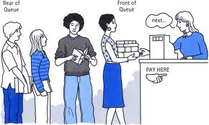

Slide 117

QUEUES
A queue is a data structure that models/enforces the first-come first-serve order, or equivalently the first-in first-out (FIFO) order.
A waiting line is a good real-life example of a queue. (In fact, the Britich word for “line” is “queue”.)

Slide 118
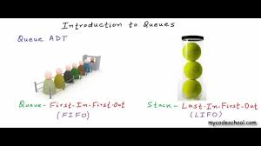

What is a Queue???????????
That is, the element that is inserted first into the queue will be the element that will deleted first, and the element that is inserted last is deleted last.

Slide 119

A Graphic Model of a Queue
Head:
All items are
deleted from
this end
Tail:
All new items
are added on
this end

Slide 120
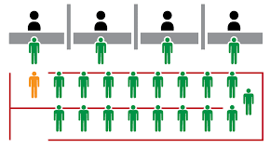
Examples of Queues
An electronic mailbox is a queue
The ordering is chronological (by arrival time)
A waiting line in a store, at a service counter, on a one-lane road
Equal-priority processes waiting to run on a processor in a computer system

Slide 121
OPERATIONS OF A QUEUE

Slide 122
The Queue Operations
A queue is like a line of people waiting for a bank teller. The queue has a front and a rear.
$ $
Front (Head)
Rear (Tail)

Slide 123
The Queue Operations
New people must enter the queue at the rear. The C++ queue class calls this a push, although it is usually called an enqueue operation.
$ $
Front (Head)
Rear (Tail)

Slide 124
The Queue Operations
When an item is taken from the queue, it always comes from the front. The C++ queue calls this a pop, although it is usually called a dequeue operation.
$ $
Rear (Tail)
Front(Head)

Slide 125
Operations on Queues
Insert(item): (also called enqueue)
It adds a new item to the tail of the queue
Remove( ): (also called delete or dequeue)
It deletes the head item of the queue, and returns to the caller. If the queue is already empty, this operation returns NULL
getHead( ):
Returns the value in the head element of the queue
getTail( ):
Returns the value in the tail element of the queue
isEmpty( )
Returns true if the queue has no items
size( )
Returns the number of items in the queue

Slide 126
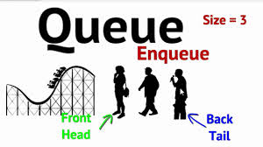
Creation of Queue
Module Create Queue
count = 0
head = 1
tail = size of queue
End Module Create Queue

Slide 127
Array Implementation
The easiest implementation also keeps track of the number of items in the queue and the index of the first element (at the front of the queue), the last element (at the rear).
3
size
0
first
2
last
[ 0 ]
[1]
[ 2 ]
[ 3 ]
[ 4 ]
[ 5 ]
. . .
4
8
6

Slide 128
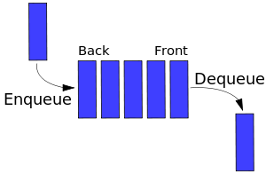
Queue Insertion
Module Enqueue
if count = size of queue
queue is full and do not insert
else
begin
increment count
increment tail
if tail > size of queue
tail = 1
endif
insert data at queue[tail]
endif
End Module Enqueue

Slide 129
Array Implementation
A queue can be implemented with an array, as shown here. For example, this queue contains the integers 4 (at the front), 8 and 6 (at the rear).
[ 0 ]
[1]
[ 2 ]
[ 3 ]
[ 4 ]
[ 5 ]
. . .
4
8
6
An array of integers to implement a queue of integers
We don't care what's in
this part of the array.

Slide 130
An Enqueue Operation
When an element enters the queue, size is incremented, and last changes, too.
3
size
1
first
3
last
[ 0 ]
[1]
[ 2 ]
[ 3 ]
[ 4 ]
[ 5 ]
. . .
8
6
2

Slide 131
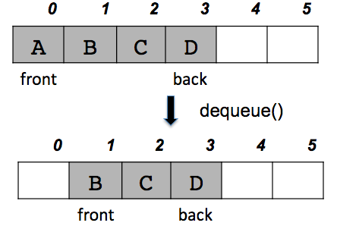
Queue Deletion
Module Dequeue
if count = 0
queue is empty and do not remove
else
begin
data = queue[head]
decrement count
increment head
if head > size of queue
head = 1
endif
endif
End Module Dequeue

Slide 132
A Dequeue Operation
When an element leaves the queue, size is decremented, and first changes, too.
2
size
1
first
2
last
[ 0 ]
[1]
[ 2 ]
[ 3 ]
[ 4 ]
[ 5 ]
. . .
4
8
6

Slide 133
Count & Free Space
Module Count
return count
End Module Count
Module Free_Space
return queue.size – count
End module Free_Space

Slide 134
At the End of the Array
There is special behavior at the end of the array. For example, suppose we want to add a new element to this queue, where the last index is [5]:
3
size
3
first
5
last
[ 0 ]
[1]
[ 2 ]
[ 3 ]
[ 4 ]
[ 5 ]
2
6
1

Slide 135
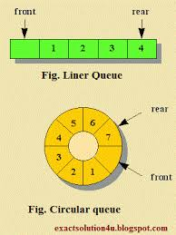
At the End of the Array
size
4
3
first
The new element goes at the front of the array (if that spot isn’t already used):
0
last
[ 0 ]
[1]
[ 2 ]
[ 3 ]
[ 4 ]
[ 5 ]
4
2
6
1

Slide 136
How head and tail Change
head increases by 1 after each dequeue( )
tail increases by 1 after each enqueue( )
tail
head
Now:
49
48
47
4
3
2
1
0
tail
head
After enqueue:
49
48
47
4
3
2
1
0
tail
head
After dequeue:
49
48
47
4
3
2
1
0

Slide 137
False-Overflow Issue First
Suppose 50 calls to enqueue have been made, so now the queue array is full
Assume 4 calls to dequeue( ) are made
Assume a call to enqueue( ) is made now. The tail part seems to have no space, but the head has 4 unused spaces; if never used, they are wasted.
49
48
47
4
3
2
1
0
49
48
47
4
3
2
1
0

Slide 138
Solution: A Circular Queue
Allow the head (and the tail) to be moving targets
When the tail end fills up and head part of the array has empty slots, new insertions should go into the head end
Next insertion goes into slot 0, and tail tracks it. The insertion after that goes into a lot 1, etc.
tail
head
49
48
47
4
3
2
1
0

Slide 139
Illustration of Circular Queues
Current state:
After One Call to enqueue()
After One Call to enqueue()
head
49
48
47
4
3
2
1
0
tail
head
tail
49
48
47
4
3
2
1
0
head
tail
49
48
47
4
3
2
1
0

Slide 140
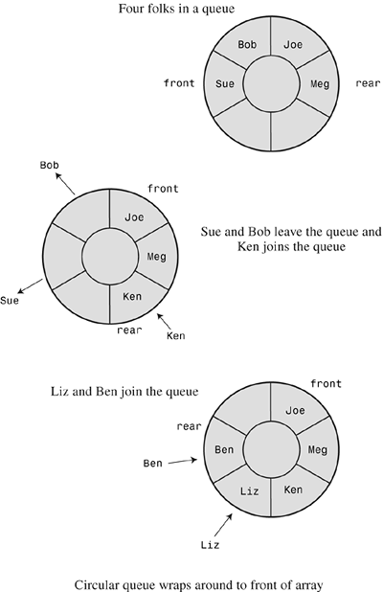
Numerics for Circular Queues
head increases by (1 modulo capacity) after each dequeue( ):
head = (head +1) % capacity;
tail increases by (1 modulo capacity) after each enqueue( ):
tail = (tail +1) % capacity;

Slide 141
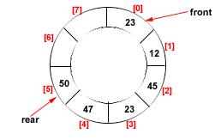
Drawback of Linear Queue
Once the queue is full, even though few elements from the front are deleted and
some occupied space is relieved, it is not possible to add anymore new elements,
as the rear has already reached the Queue’s rear most position.
Circular Queue
This queue is not linear but circular.
Its structure can be like the following figure:
In circular queue, once the Queue is full the
"First" element of the Queue becomes the
"Rear" most element, if and only if the "Front"
has moved forward. otherwise it will again be
a "Queue overflow" state.
Figure: Circular Queue having
Rear = 5 and Front = 0
141

Slide 142
Algorithms for Insert and Delete Operations in Circular Queue
For Insert Operation
void cEnqueue (int x)
{
if (front==(rear+1)%maxsize)
Printf(“queue overflow”);
else
{
if(front==-1)
front=rear=0;
else
rear=(rear+1)%maxsize;
cQueue[rear]=x;
}
}
142

Slide 143
For Delete Operation
int cDequeue()
{
if (front==-1)
printf(“queue underflow”);
Else
{
x=cQueue[front];
if(front==rear)
front=rear=-1;
else
front=(front+1) % maxsize;
}
return x;
}
143

Slide 144
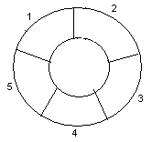
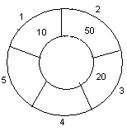
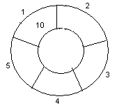
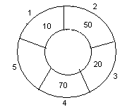
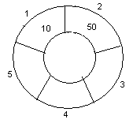
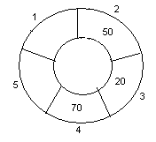
Example: Consider the following circular queue with N = 5.
1. Initially, Rear = 0, Front = 0.
4. Insert 20, Rear = 3, Front = 1.
Front
Rear
2. Insert 10, Rear = 1, Front = 1.
5. Insert 70, Rear = 4, Front = 1.
Rear
Front
Front
Rear
3. Insert 50, Rear = 2, Front = 1.
6. Delete front, Rear = 4, Front = 2.
Front
Rear
Front
Rear
144

Slide 145
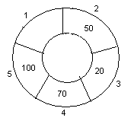
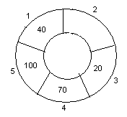
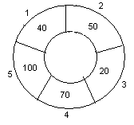
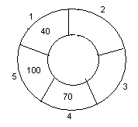
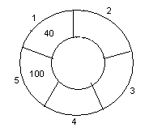
7. Insert 100, Rear = 5, Front = 2.
10. Delete front, Rear = 1, Front = 3.
Front
Rear
Front
Rear
8. Insert 40, Rear = 1, Front = 2.
11. Delete front, Rear = 1, Front = 4.
Rear
Rear
Front
Front
9. Insert 140, Rear = 1, Front = 2.
As Front = Rear + 1, so Queue overflow.
12. Delete front, Rear = 1, Front = 5.
Rear
Rear
Front
Front
145

Slide 146
Full and empty queues
If the queue were to become completely full, it would look like this:
0 1 2 3 4 5 6 7
myQueue:
44
55
66
77
88
11
22
33
tail = 4
head = 5
If we were then to remove all eight elements, making the queue completely empty, it would look like this:
0 1 2 3 4 5 6 7
myQueue:
tail = 4
head = 5
This is a problem!

Slide 147
Full and empty queues: solutions
Solution #1: Keep an additional variable
0 1 2 3 4 5 6 7
myQueue:
44
55
66
77
88
11
22
33
count = 8
rear = 4
front = 5
Solution #2: (Slightly more efficient) Keep a gap between elements: consider the queue full when it has n-1 elements
0 1 2 3 4 5 6 7
myQueue:
44
55
66
77
11
22
33
rear = 3
front = 5

Slide 148
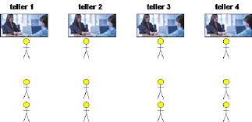
Applications of Queue
Operating systems often maintain a queue of processes that are ready to execute or that are waiting for a particular event to occur.
Computer systems must often provide a “holding area” for messages between two processes, two programs, or even two systems. This holding area is usually called a “buffer” and is often implemented as a queue.
Serving requests on a single shared resource, like a printer, CPU task scheduling etc.
In real life, Call Center phone systems will use Queues, to hold people calling them in an order, until a service representative is free.
Handling of interrupts in real-time systems. The interrupts are handled in the same order as they arrive, First come first served.

Slide 149


PROS AND CONS OF QUEUES
Easy to implement
But it has a limited capacity with a fixed array
Or you must use a dynamic array for an unbounded capacity
Special behaviour is needed when the rear reaches the end of the array. (Over come by CIRCULAR QUEUES)
ADVANTAGES OF CIRCULAR QUEUES
A standard queue suffers from a rebuffering problem during dequeue operations.
By making the queue circular and linking the head to the tail, this alleviates the problem and allows insertion and deletion in constant time.

Slide 150
Queue Linked List Implementation

Slide 151
Queue Implementation
struct Node
{
int data;
struct Node *next;
}*front = NULL,*rear = NULL;

Slide 152

Queue Implementation
Enqueue

Slide 153

Contd..

Slide 154


Enqueue
void insert(int value)
{
struct Node *newNode;
newNode = (struct Node*)malloc(sizeof(struct Node));
newNode->data = value;
newNode -> next = NULL;
if(front == NULL)
front = rear = newNode;
else{
rear -> next = newNode;
rear = newNode;
}
printf("\nInsertion is Success!!!\n");
}

Slide 155

Dequeue
void delete()
{
if(front == NULL) printf("\nQueue is Empty!!!\n");
else{
struct Node *temp = front;
front = front -> next;
printf("\nDeleted element: %d\n", temp->data);
free(temp);
}
}

Slide 156
Applications of Queue Priority Queue

Slide 157
Priority Queue
A Priority Queue – a different kind of queue.
Similar to a regular queue:
insert in rear,
remove from front.
Items in priority queue are ordered by some key
Item with the lowest key / highest key is always at the front from where they are removed.
Items then ‘inserted’ in ‘proper’ position
Idea behind the Priority Queue is simple:
Is a queue
But the items are ordered by a key.
Implies your ‘position’ in the queue may be changed by the arrival of a new item.
157

Slide 158
Applications of Priority Queues
Many, many applications.
Scheduling queues for a processor, print queues, transmit queues, backlogs, etc.….
This means this item will be in the front of queue
“Obtained” via a remove().
Note: a priority queue is no longer FIFO!
You will still remove from front of queue, but insertions are governed by a priority.
158

Slide 159
Priority Queues: Access
remove()
So, the first item has priority and can be retrieved (removed) quickly and returned to calling environment.
Hence, ‘remove()’ is easy (and will take O(1) time)
insert()
But, we want to insert quickly. Must go into proper position.
For our purposes here: Implementing data structure: array;
slow to insert(), but for
small number of items in the pqueue, and
where insertion speed is not critical,
this is the simplest and best approach.
159

Slide 160
Priority Queues
Operations performed on priority queues
Find an element,
Insert a new element
Delete an element, etc.
Two kinds of (Min, Max) priority queues exist:
In a Min priority queue, find/delete operation finds/deletes the element with minimum priority
In a Max priority queue, find/delete operation finds/deletes the element with maximum priority
Two or more elements can have the same priority

Slide 161
Implementation of Priority Queues
Implemented using heaps and leftist trees
Heap is a complete binary tree that is efficiently stored using the array-based representation
Leftist tree is a linked data structure suitable for the implementation of a priority queue

Slide 162
Heap Operations
When n is the number of elements (heap size),
Insertion ➔ O(log₂n)
Deletion ➔ O(log₂n)
Initialization ➔ O(n)

Slide 163
Complexity of Deletion
The time complexity of deletion is the same as insertion
At each level, we do Θ(1) work
Thus the time complexity is O(height) = O(log₂n), where n is the heap size

Slide 164
DEQUES (Double Ended Queue)
Elements can be added or removed at either end but not in the middle

Slide 165
Double Ended Queue

Slide 166

Double-Ended Queue
A Deque or deck is a double-ended queue.
Allows elements to be added or removed on either the ends.

Slide 167
TYPES OF DEQUE
Input restricted Deque
Elements can be inserted only at one end.
Elements can be removed from both the ends.
Output restricted Deque
Elements can be removed only at one end.
Elements can be inserted from both the ends.

Slide 168
Deque as Stack and Queue
As STACK
When insertion and deletion is made at the same side.
As Queue
When items are inserted at one end and removed at the other end.

Slide 169
OPERATIONS IN DEQUE
Insert element at back
Insert element at front
Remove element at front
Remove element at back

Slide 170
Insert_front
insert_front() is a operation used to push an element into the front of the Deque.
PUSH 0
1 2 3 4 5 7
FRONT
REAR
0 1 2 3 4 5 7

Slide 171
Algorithm Insert_front
step1. Start
step2. Check the queue is full or not as if (r == max-1) &&(f==0)
step3. If false update the pointer f as f= f-1
step4. Insert the element at pointer f as Q[f] = element
step5. Stop

Slide 172
Insert_back
insert_back() is a operation used to push an element at the back of a Deque.
1 2 3 4 5 7
PUSH 9
FRONT
REAR
1 2 3 4 5 7

Slide 173
Alogrithm insert_back
Step1: Start
Step2: Check the queue is full or not as if (r == max-1) &&(f==0) if yes queue is full
Step3: If false update the pointer r as r= r+1
Step4: Insert the element at pointer r as Q[r] = element
Step5: Stop

Slide 174
Remove_front
remove_front() is a operation used to pop an element on front of the Deque.
POP
1 2 3 4 5 7
FRONT
REAR
9
2 3 4 5 7

Slide 175
Alogrithm Remove_front
Step1: Start
Step2: Check the queue is empty or not as if (f == r) if yes queue is empty.
Step3: If false update pointer f as f = f+1 and delete element at position f as element = Q[f]
Step4: If ( f== r) reset pointer f and r as f = r = -1
Step5: Stop

Slide 176
Remove_back
remove_front() is a operation used to pop an element on front of the Deque.
1 2 3 4 5 7
POP
FRONT
REAR
1 2 3 4 5

Slide 177
Alogrithm Remove_back
step1. Start
step2. Check the queue is empty or not as if (f == r) if yes queue is empty
step3. If false delete element at position r as element = Q[r]
step4. Update pointer r as r = r-1
step5. If (f == r ) reset pointer f and r as f = r= -1
step6. Stop

Slide 178
Empty
It is used to test weather the Deque is empty or not.

Slide 179

APPLICATIONS OF DEQUE
Palindrome-checker

Slide 180
APPLICATIONS OF DEQUE
A-Steal job scheduling algorithm
The A-Steal algorithm implements task scheduling for several processors(multiprocessor scheduling).
The processor gets the ﬁrst element from the deque.
When one of the processor completes execution of its own threads it can steal a thread from another processor.
It gets the last element from the deque of another processor and executes it.

Slide 181
OTHER APPLICATIONS OF DEQUE
Undo-Redo operations in Software applications.
Storing a web browser's history. Recently visited URLs are added to the front of the deque, and the URL at the back of the deque is removed after some specified number of insertions at the front.

Slide 182
Real Time Implementation
There are pile of dinner plates that you encounter when you eat at the local cafeteria: When you remove a plate from the pile, you take the plate on the top of the pile. But this is exactly the plate that was added ("inserted'') most recently to the pile by the dishwasher. If you want the plate at the bottom of the pile, how could u do that. Demonstrate using animation.

Slide 183
Thank You

